Slide 1
STAT 3505 Final Project
Jeen Kang, Jennifer Vaughn,
Tyler Wood

Slide 2
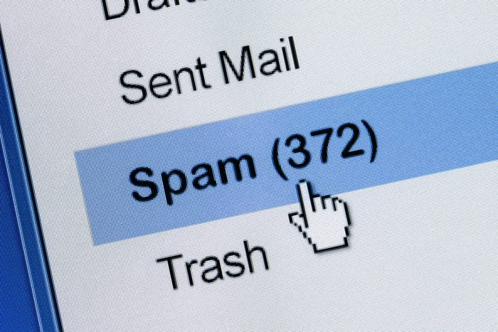
Problem
In our digitally-driven world, junk and scam emails are more apparent than ever. They clutter our inboxes and put a risk to our security. It is important for email platforms to accurately detect junk emails to protect users and maintain their platform as a reliable communication tool. There is a need for developing better techniques and tools to detect and filter these emails to enhance the user experience and security.

Slide 3
Analysis Questions & Hypotheses
Analysis Questions
Is it possible to predict junk email from frequencies of certain keywords?
Can sequences of consecutive capital letters predict junk email?
Our Collective Hypotheses
Yes, certain words are more commonly found in junk emails than non-junk emails to attract a user’s attention.
Yes, an overuse of capital letters is commonly found in junk mail in an attempt to express urgency.

Slide 4
The Dataset
SAS built-in dataset “Junk Mail”
Classifies 4,601 email observations as junk email or non-junk email using 59 numeric variables
Variables:
Test: 0 - Training, 1 - Test
54 different keywords
Examples: Business, Money, Conference
CapAvg: Capital Run Length Average
CapLong: Capital Run Length Longest
CapTotal: Capital Run Length Total
Class: 0 - Not Junk, 1 - Junk
Binary target variable
Variables we care about for our project:
Test
The 54 keywords
CapAvg
Class
Variables we don’t care about and will drop:
CapTotal
CapLong

Slide 5
Our Solution Plan
Find data for the 2 criteria we want to use to predict junk email
Do basic exploratory data analysis
Build a logistic regression model for each of the 2 criteria
Evaluate how well our models predict
Answer our analysis questions
Reach a final conclusion

Slide 6
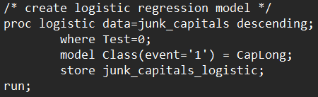
Method of Analysis
Exploratory data analysis
proc means
Logistic regression
proc logistic
Evaluate the model
proc sql
proc plm
proc freq (confusion matrix)

Slide 7
Results
Answers to Analysis Questions
Is it possible to predict junk email from frequencies of certain keywords?
Yes, it is possible to predict if an email is junk based on certain keyword frequencies with a 92.56% TPR and 92.75% TNR.
Can sequences of consecutive capital letters predict junk email?
Yes, it is possible to predict if an email is junk based on long sequences of consecutive capital letters with a 79.25% TPR and 70.05% TNR.
Model 1 (keyword frequencies):
True negative rate (TNR): 92.75%
True positive rate (TPR): 92.56%
Model 2 (consecutive capital letters):
TNR: 70.05%
TPR: 79.25%

Slide 8
Conclusion
Our results prove that it is possible to use the features of previous junk emails to predict whether incoming emails are junk or not.
More robust technologies and tools can be developed by professionals at email platform companies to effectively classify and filter out junk/scam emails that their users receive to improve the user experience and security.

